Slide 1
JOB DESCRIPTION
SKILL EXTRACTION USING
NATURAL LANGUAGE PROCESSING
PROJECT PROFILE
Natural Language Processing (NLP) & Skill Extraction
Primary dataset: raw_jobs_2500_records.csv
Analytics: Microsoft Power BI
Application: Web-based Skill Extraction System
Frontend: Streamlit
Backend: Python
Deployment: GitHub + Streamlit Community Cloud
Duration: 19 Days
NLP, Machine Learning, Analytics and Application Development Project
JOB DESCRIPTION
→
NLP
→
SKILLS
→
ANALYTICS
→
APPLICATION
Presented By - Tanuja Holkar

Slide 2
PROBLEM STATEMENT
Turning unstructured job text into structured, usable information
Unstructured text
Why Job Skill Extraction is Needed
Technical information is embedded inside long job descriptions.
Manual effort
1. Helps to reduce the manual efforts
Identifying skills repeatedly is time-consuming and difficult to scale.
Standardization
2. Helps recruiters to identify quickly
Synonyms, variants and formatting differences create inconsistency.
Analytics barrier
Raw text is harder to aggregate, categorize and analyze.
3. Enables skill normalization, categorization and further analysis
JOB DESCRIPTION SKILL EXTRACTION • PROJECT DEFENSE
02

Slide 3
BUSINESS USE CASE
Where Can the System Be Used?
01 Recruitment & HR Description – Quickly identify required skills from job descriptions
02 Job Portls - Extract and standardize skills from job posting
03 Resume Screening – Compare required skills with candidate skills
04
04 Skill Gap Analysis – Identify missing skills for a particular job role
05 Career & Learning Platform – Recommend skill/courses based on job requirement
JOB DESCRIPTION SKILL EXTRACTION • PROJECT DEFENSE
03

Slide 4
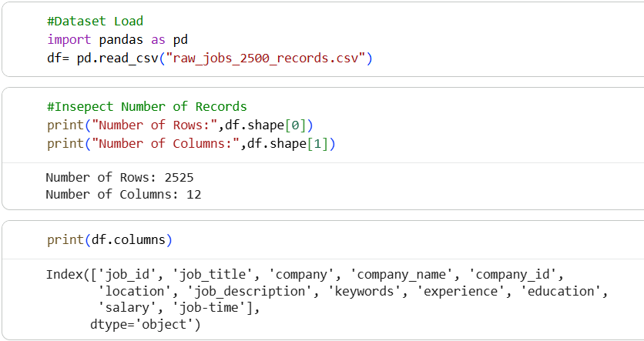
DATASET
Dataset Understanding
Starting from 2525 raw job records
Dataset fields
2525
12
2500
30
job_id — Unique job identifier
job_title — Job role/title
company — Company name
Company — Unique Company- Id
location — Job location
job_description — Main NLP text
experience — Experience requirement
education — Education requirement
salary — Salary information
job_type — Type of employment
Keywords — Keypoints
Initial records
Fields
Working / EDA records
Unique job titles
SCREENSHOT PLACEHOLDER
INSERT ORIGINAL DATASET INSPECTION SCREENSHOT
Evidence: head / shape / columns / missing values / duplicate inspection
JOB DESCRIPTION SKILL EXTRACTION • PROJECT DEFENSE
04

Slide 5
DATA CLEANING
Data Cleaning & Text Preparation
Raw Dataset
Removing noise before NLP and skill matching
Why cleaning matters
Data Inspection
It reduces irrelevant tokens and makes descriptions more consistent for downstream extraction and modeling.
Missing Value Check
Duplicate Check
01. Remove URLs / Link
02. Remove Email Id
Remove Duplicate Records
Remove Unwanted Noise
03. Remove Special characters
04. Remove Extra Spaces
Remove Extra Spaces
Clean Dataset
NLP Processing
JOB DESCRIPTION SKILL EXTRACTION • PROJECT DEFENSE
05

Slide 6
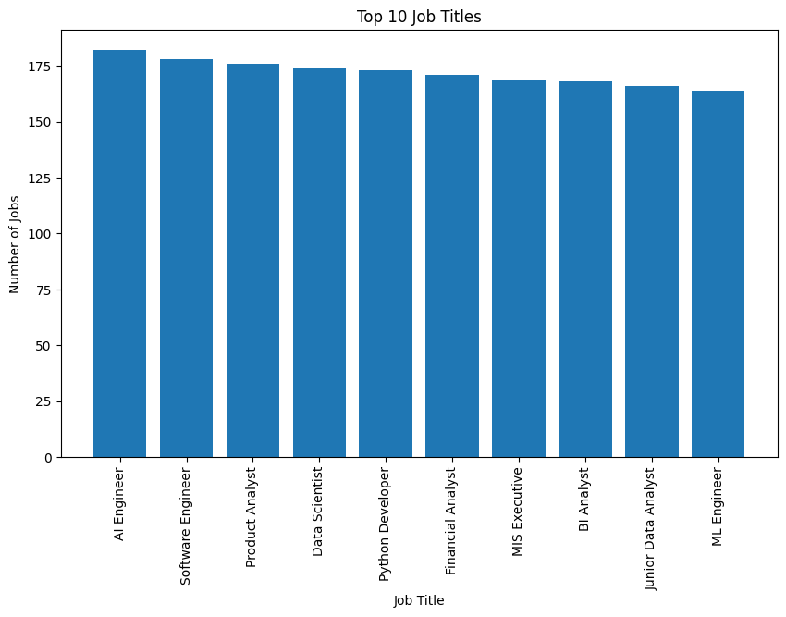
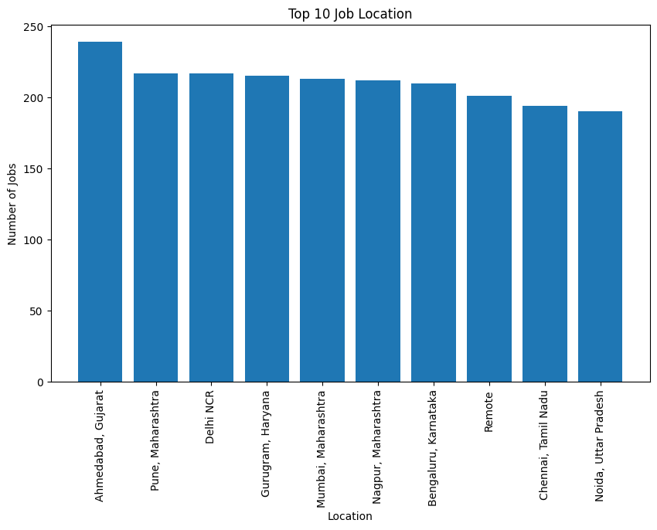
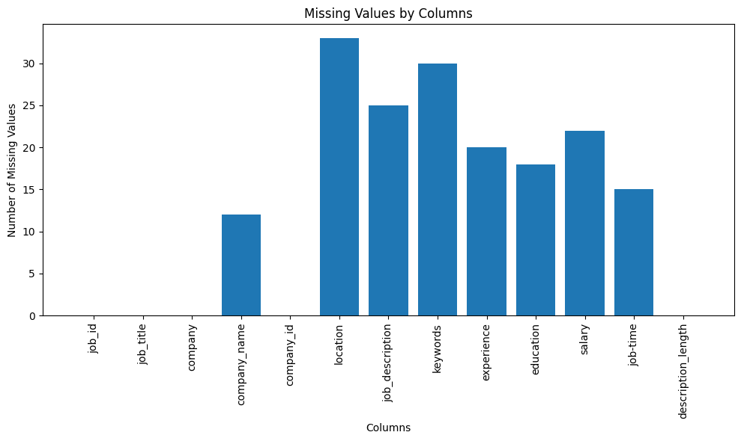
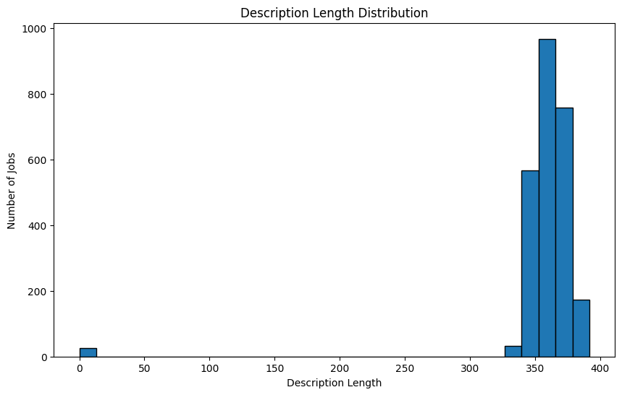
EDA
Exploratory Data Analysis
Understanding the working dataset before modeling
2,500
30
EDA SCREENSHOT
TOP JOB TITLES / ROLES
EDA SCREENSHOT
TOP LOCATIONS
EDA / working records
Unique job titles
Data quality
Missing-value and duplicate checks were performed before downstream modeling.
Text analysis
EDA SCREENSHOT
MISSING / DUPLICATES
EDA SCREENSHOT
COMPANIES / DESCRIPTION LENGTH
Description length was analyzed to understand available NLP input.
Distribution checks
Roles, locations and companies were reviewed.
JOB DESCRIPTION SKILL EXTRACTION • PROJECT DEFENSE
06

Slide 7
NLP PIPELINE
End-to-End NLP Pipeline
Multiple techniques were explored across the 19-day development process
Job Description
Preprocessing
Tokenization • sentence segmentation • stopwords • lowercase • lemmatization
Text Preprocessing
Feature
Skill Extraction
TF-IDF • unigrams • bigrams • trigrams
Skill Normalization
Semantic
Skill Categorization
Embeddings • cosine similarity
Model Evaluation
Skill Analysis
JOB DESCRIPTION SKILL EXTRACTION • PROJECT DEFENSE
07

Slide 8
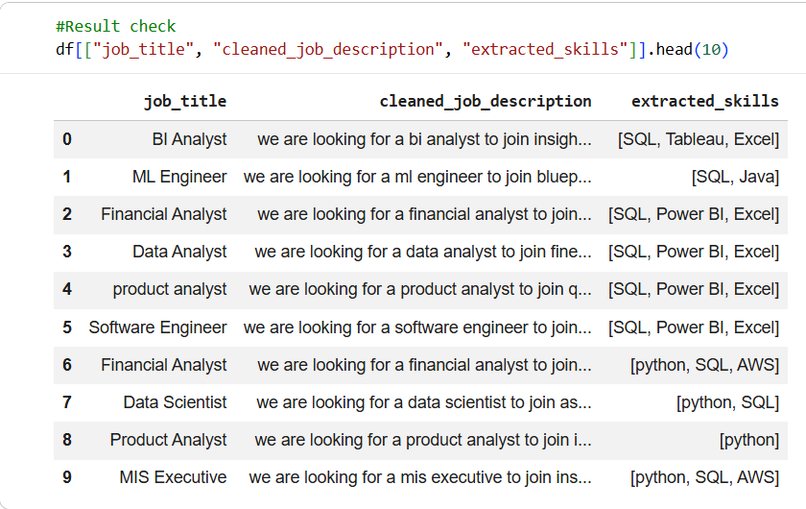
RULE-BASED
Rule-Based Skill Extraction
Transparent, fast and explainable extraction
Skill taxonomy
Normalization examples
SCREENSHOT PLACEHOLDER
INSERT ORIGINAL RULE / REGEX /
PHRASE MATCHER EVIDENCE
Canonical skill + category + aliases / synonyms
Python3 → Python
Python 3 → Python
Python programming → Python
PowerBI → Power BI
Power-BI → Power BI
Postgres → PostgreSQL
Dictionary matching
Checks whether known skills occur in the job-description text.
Regex + phrase matching
Handles controlled patterns and multi-word technical skills.
Limitation
Performance depends strongly on taxonomy coverage.
JOB DESCRIPTION SKILL EXTRACTION • PROJECT DEFENSE
08

Slide 9
MACHINE LEARNING
Machine Learning Approach
TF-IDF is the feature representation; Logistic Regression is the classifier
TEXT
2525
2020 / 505
0.9793
↓
Labeled examples
Train / test
ML accuracy
TF-IDF FEATURES
↓
SKILL
CLOUD
DATABASE
LOGISTIC REGRESSION
↓
BI_TOOL
4 PROJECT CATEGORIES
JOB DESCRIPTION SKILL EXTRACTION • PROJECT DEFENSE
09

Slide 10
TRANSFORMER
Transformer-Based Approach
A pretrained BERT-NER model was evaluated as a qualitative baseline
Model
Example input
Why this matters
dslim/bert-base-NER
Aggregation: simple
“Experience with Python, SQL and AWS.”
Project-specific categories can distinguish technical concepts more directly.
Python → SKILL
SQL → SKILL / DATABASE (depending on taxonomy)
AWS → CLOUD_PLATFORM
Docker → TOOL
Kubernetes → TECHNOLOGY
Purpose
Test how a general-purpose NER model handles technical terms in job descriptions.
Observed concept
Critical limitation
Python → MISC
SQL → MISC
AWS → MISC
Pretrained baseline — not fine-tuned for project-specific skill categories.
BERT
1
BERT
2
BERT
3
JOB DESCRIPTION SKILL EXTRACTION • PROJECT DEFENSE
10

Slide 11
EVALUATION
Model Evaluation & Comparison
Approach
Accuracy
Precision
Recall
F1
Dictionary Matching
0.9529
0.9595
0.9782
0.9678
Regex Matching
0.9870
0.9782
0.9782
0.9782
Custom NER
0.7316
0.9782
0.7317
0.8265
ML
0.9793
0.9861
0.9832
0.9842
TF-IDF
0.9253
0.9589
0.9498
0.9516
Key result
TF-IDF + Logistic Regression produced the strongest directly comparable numerical result on the constructed Day 15 evaluation set.
JOB DESCRIPTION SKILL EXTRACTION • PROJECT DEFENSE
11

Slide 12
ERROR ANALYSIS
Error Analysis
Looking beyond accuracy to understand extraction failures
False Positive
False Negative
Wrong Entity
Partial Entity
Duplicate Skill
Unknown Skill
Synonym Problem
Spelling Problem
Taxonomy gap
Variation
Synonyms
Labels
PostgreSQL was an important coverage issue.
Duplicate / format differences can affect matching.
Different expressions may refer to the same skill.
Some original hand-written labels were inaccurate.
SCREENSHOT PLACEHOLDER
INSERT ORIGINAL ERROR-ANALYSIS
WORKBOOK / OUTPUT
JOB DESCRIPTION SKILL EXTRACTION • PROJECT DEFENSE
12

Slide 13
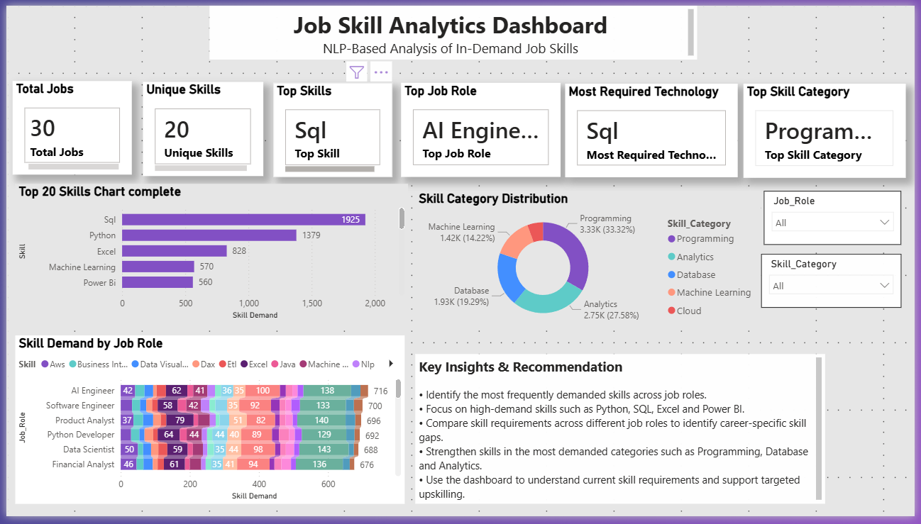
DASHBOARD
Power BI Dashboard
Turning processed skills into business-facing analytics
INSERT ORIGINAL COMPLETED POWER BI DASHBOARD SCREENSHOT HERE
JOB DESCRIPTION SKILL EXTRACTION • PROJECT DEFENSE
13

Slide 14
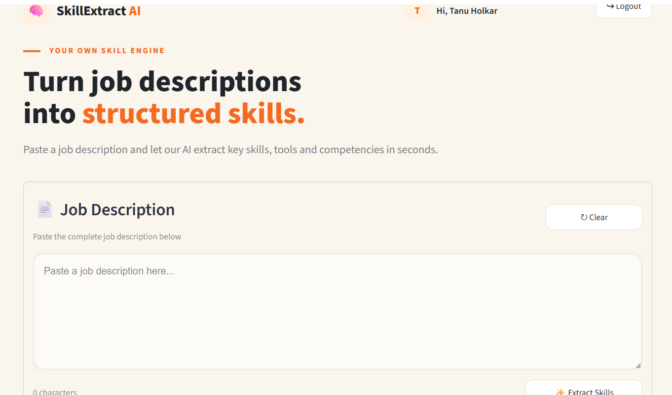
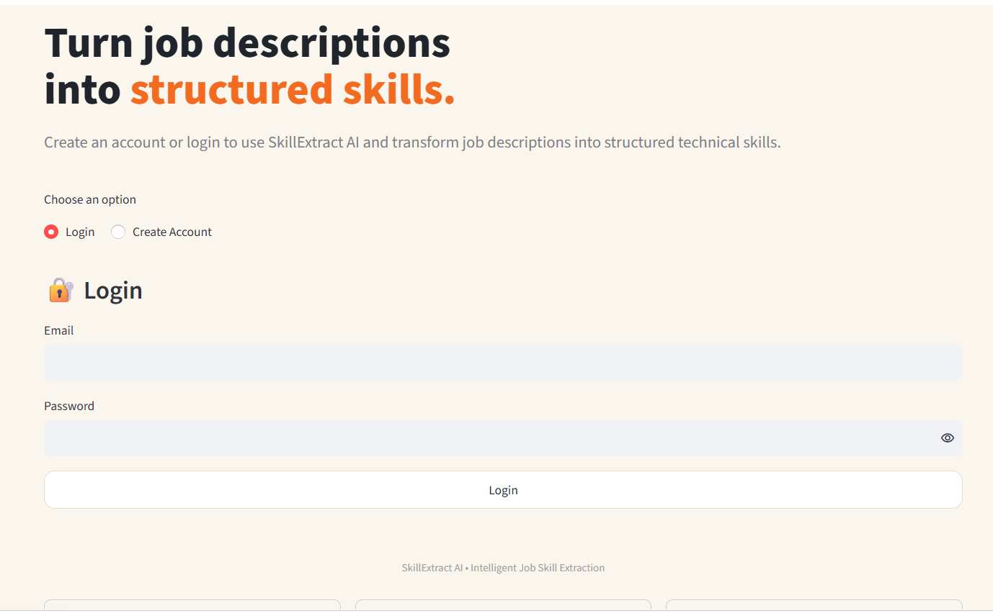
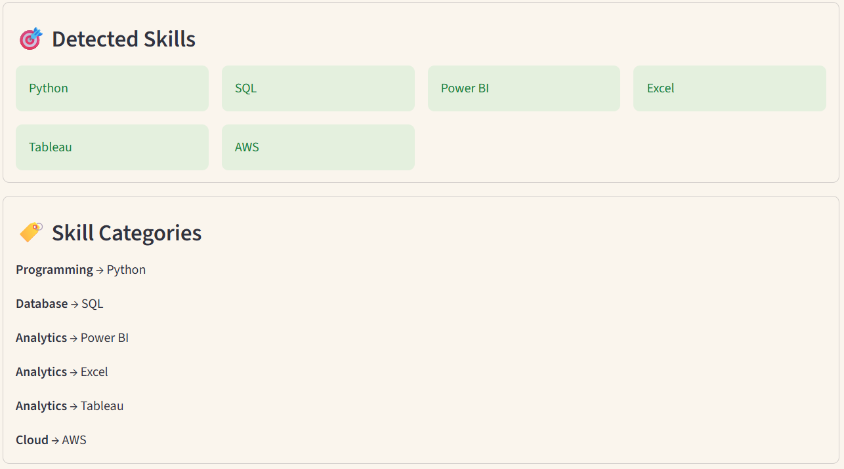
APPLICATION DEMO
Final Web Application
Production-oriented workflow: taxonomy + regex/aliases + normalization + category mapping
User interaction
Paste JD → submit → backend processes → skills detected → normalized → categorized → CSV export.
JOB DESCRIPTION SKILL EXTRACTION • PROJECT DEFENSE
14

Slide 15
CONCLUSION
Conclusion
From raw job-description text to structured technical-skill information
RAW JD
→
CLEAN
→
EXTRACT
→
NORMALIZE
→
CATEGORIZE
→
EVALUATE
→
ANALYZE
→
APPLICATION
DATA
NLP
ML + EVALUATION
PRODUCTIZATION
Dataset understanding
Data cleaning
EDA
Preprocessing
Taxonomy + matching
TF-IDF / NER / BERT benchmark
Logistic Regression
Metrics + confusion matrix
Error analysis
Normalization
Power BI dashboard
Streamlit + Python application
The project demonstrates the complete path from unstructured job-description text to structured technical-skill information, analytics and a working application.
JOB DESCRIPTION SKILL EXTRACTION • PROJECT DEFENSE
15

Slide 16
FUTURE IMPROVEMENTS
Future Improvements
A roadmap from the current system toward broader recruitment intelligence
01
Expand Skill Taxonomy
02
Larger Evaluation Dataset
Emerging technologies, tools and aliases
Professionally annotated data for stronger measurement
03
Fine-Tuned Transformer
04
Unknown-Skill Detection
Project-specific skill entities and categories
Fuzzy matching + semantic validation
05
Resume-to-Job Matching
06
Skill-Gap Analysis
Compare job skills with resume skills
Identify missing skills for a role
07
Candidate Ranking
08
Learning Recommendations
Rank candidates by skill alignment
Suggest resources for skill gaps
09
Time-Based Trends
10
Production Improvements
Use reliable dates when available
Versioning, monitoring, taxonomy updates, deployment architecture
Current System → Better Taxonomy → Better Models → Larger Evaluation → Resume Matching → Skill Gap → Recruitment Intelligence
JOB DESCRIPTION SKILL EXTRACTION • PROJECT DEFENSE
16

